Slide 1
Introduction to Logistic Regression and Support Vector Machine
Instructor: Wei Ding

Slide 2
Let’s have some discussion on regression, overfitting, and regularization

Slide 3
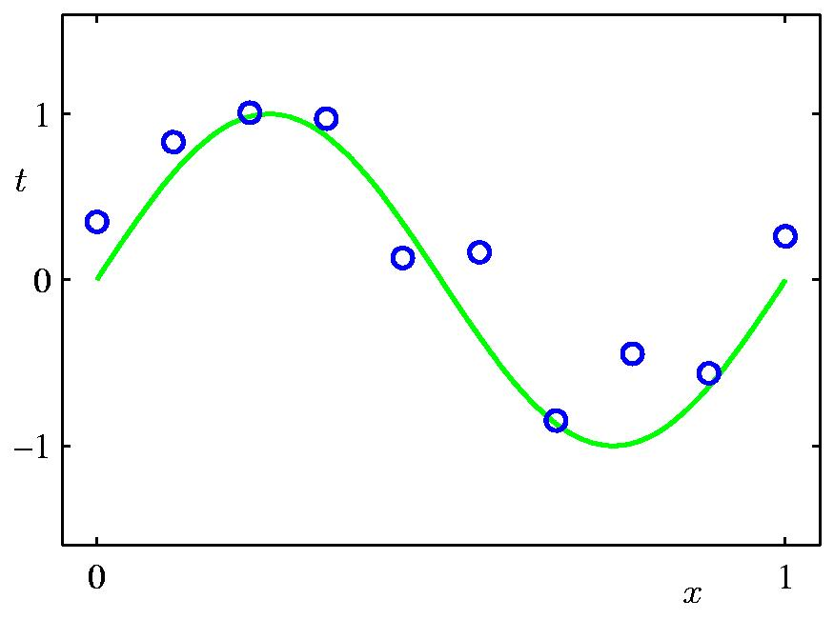
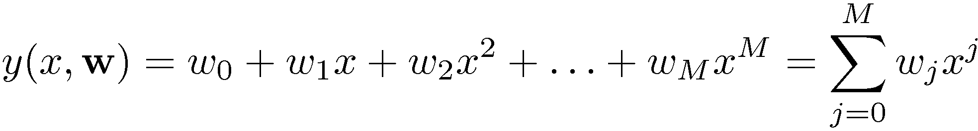
Polynomial Curve Fitting (Regression)
In real data set, individual observations are often corrupted by random noise.
Plot of a training data set of N=10 points, shown as blue circles, each comprising an observation of the input variable x along with the corresponding target variable t.
The green curve shows the function sin(2πx) used to generate the data.
Goal: to predict the value of t for some new value of x, without knowledge of the green curve.

Slide 4
Polynomial Curve Fitting
M is the order of the polynomial
X^{j} denote x raised to the power of j
The polynomial coefficients 1, …, w_{m} are collectively denoted by the vector w
The polynomial function y(x,w) is a nonlinear function of x, it is a linear function of the coefficients w.
Linear models: functions are linear in the unknown parameters are called linear models.

Slide 5
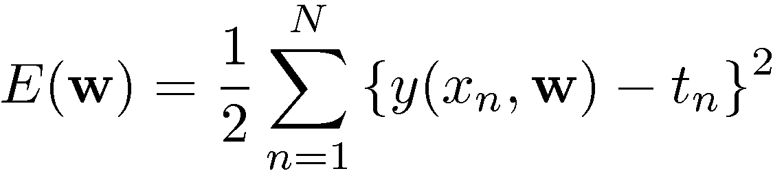
Error Function
The sum of the squares of the errors between the predictions y(x_{n},w) for each data point x_{n} and the corresponding target values t_{n}
The values of the coefficients will be determined by fitting the polynomial to the training data
This can be done by minimizing an error function that measure the misfit between the function y(x,w), for any given value of w, and the training set data points.

Slide 6
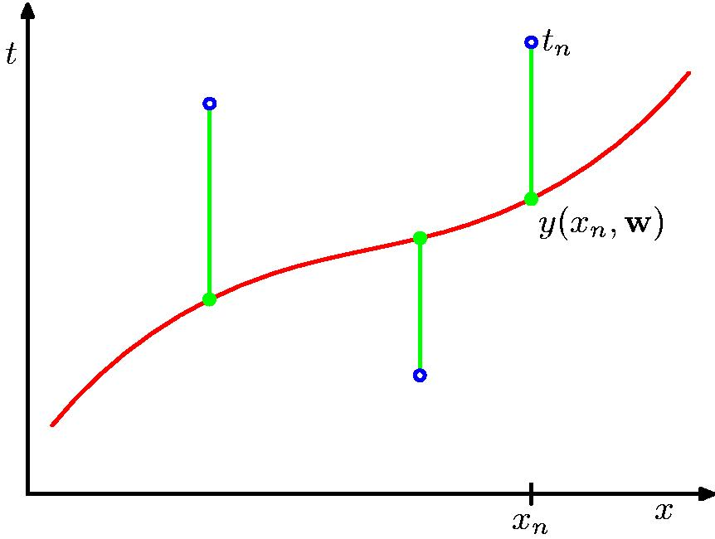
Sum-of-Squares Error Function
When E(w)=0?

Slide 7
Solving the Curve Fitting Problem
Choosing the value of w for which E(w) is as small as possible
Because the error function is a quadratic function of the coefficients w, its derivatives with respect to the coefficients will be linear in the elements of w, and so the minimization of the error function has a unique solution, denoted by w*, which can be found in closed form.
The resulting polynomial is given by the function y(x, w*).

Slide 8
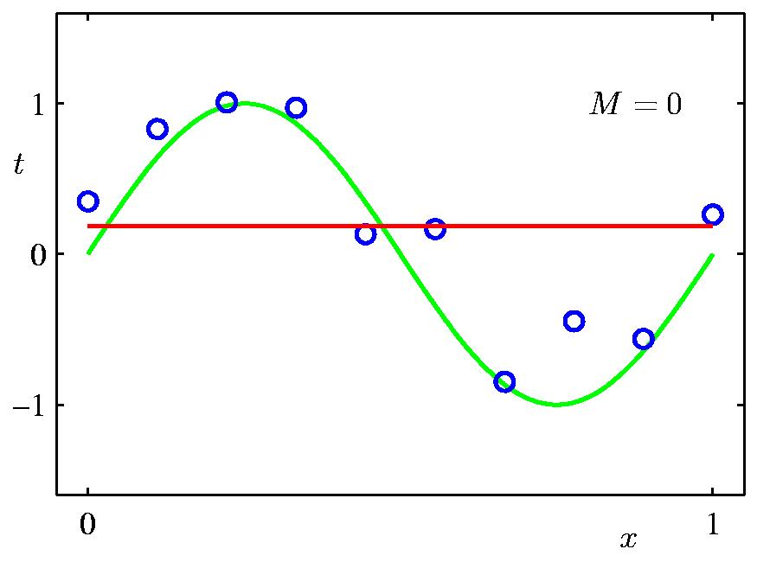
0th Order Polynomial
Poor fitting

Slide 9
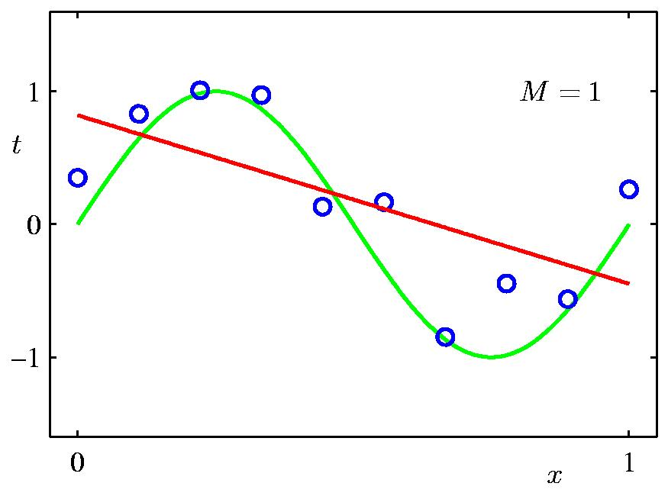
1st Order Polynomial
Poor fitting

Slide 10
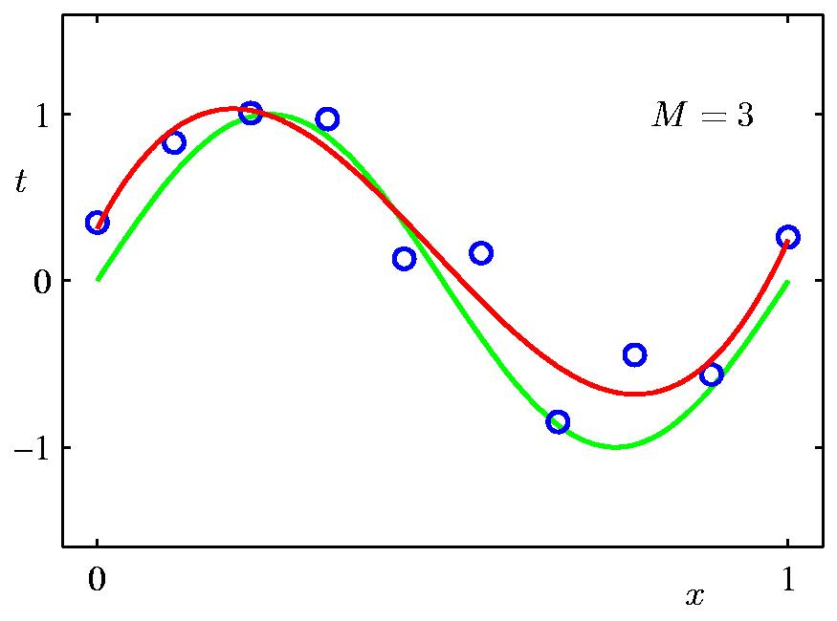
3rd Order Polynomial
Excellent fitting

Slide 11
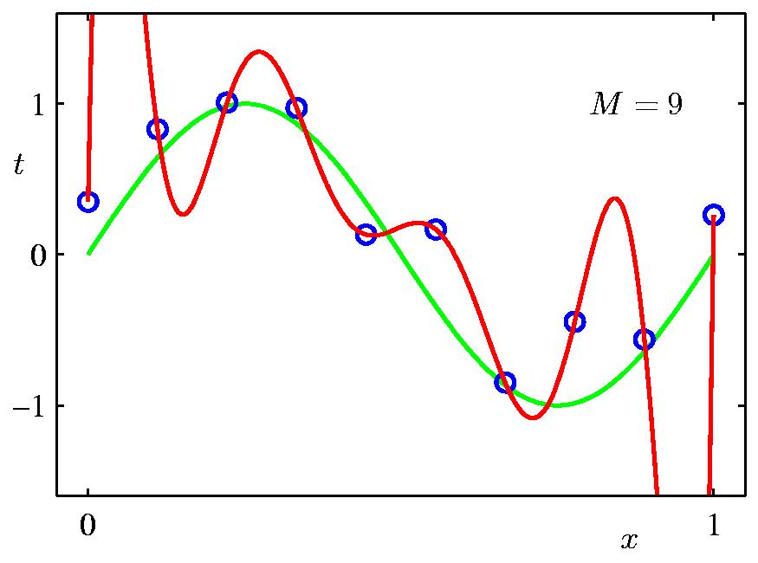
9th Order Polynomial
Over-fitting
The polynomial passes exactly through each data point and E(w*)=0. However, the fitted curve oscillates widely and gives a vary representation of the function sin(2πx)

Slide 12
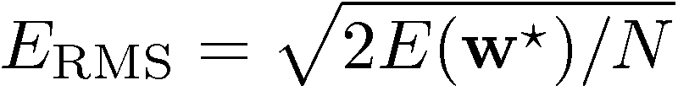
Root-Mean-Square (RMS) Error
Root-Mean-Square (RMS) Error:
Each choice of M, we can evaluate error for the test data set.
RMS for the test data set.
Division by N allows us to compare different sizes of data sets on an equal footing
The square root ensures that E_{RMS} is measured as the same scale (and in the same units) as the target variable t.

Slide 13
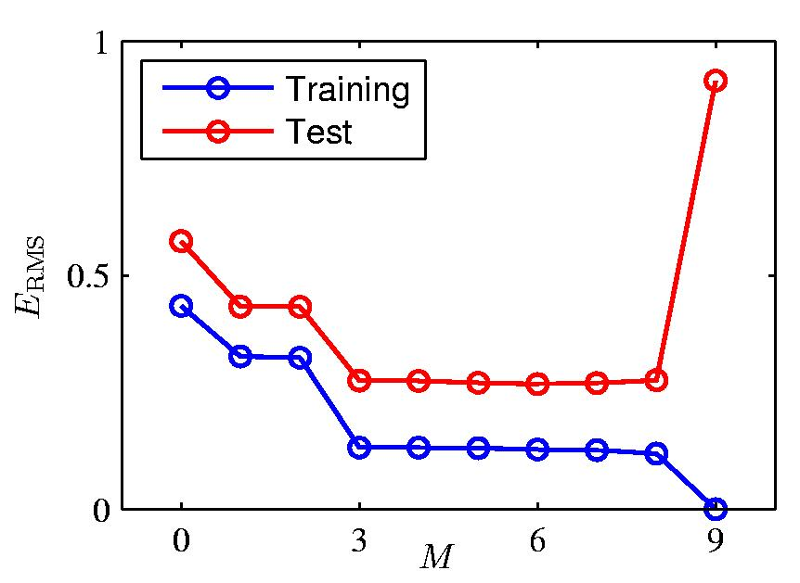
Over-fitting
Graphs of the training and test set RMS errors are shown, for various value of M.
The test set error is a measure of how well we are doing in predicting the values of t for new data observations of x.
Values of M in the range 3<=M<=8 give small values for the test set error, and these also give reasonable representations of the generating function sin(2πx)
Root-Mean-Square (RMS) Error:

Slide 14
Over-Fitting
For M=9, the training set error goes to zero.
Because this polynomial contains 10 degrees of freedom corresponding to the 10 coefficients w₀,…,w₉, and so can be tuned exactly to the 10 data points in the training set.
However, the test set error has become very large and the corresponding function y(x,w*) exhibits wild oscillations.

Slide 15
Paradox
A polynomial of given order contains all lower order polynomials as special case
The M=9 polynomial is therefore capable of generating results at least as good as the M=3 polynomial.
The best predicator of new data would be the function sin(2πx) contains terms of all orders.
We know that a power series expansion of the function sin(2πx) contains terms of all orders, so we might expect that results should improve monotonically as we increase M

Slide 16

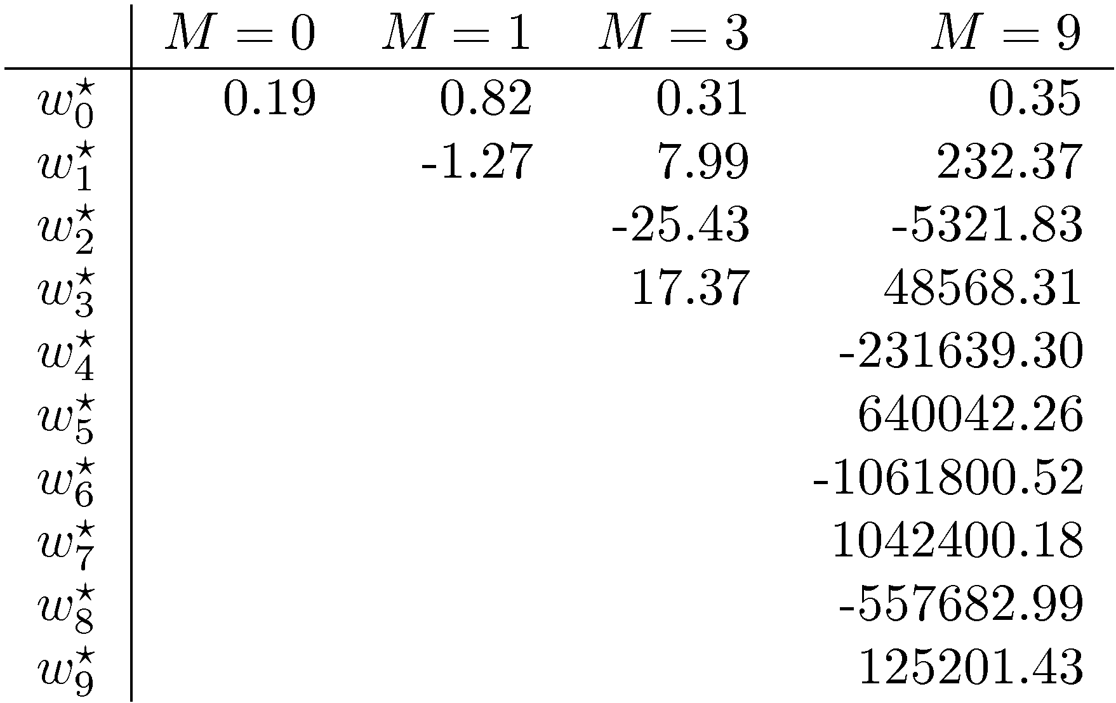
Polynomial Coefficients
The more flexible polynomials with larger values of M are becoming increasingly tuned to the random noise on the target values.

Slide 17
It is also interesting to examine the behavior of a given model as the size of the data set is varied…

Slide 18

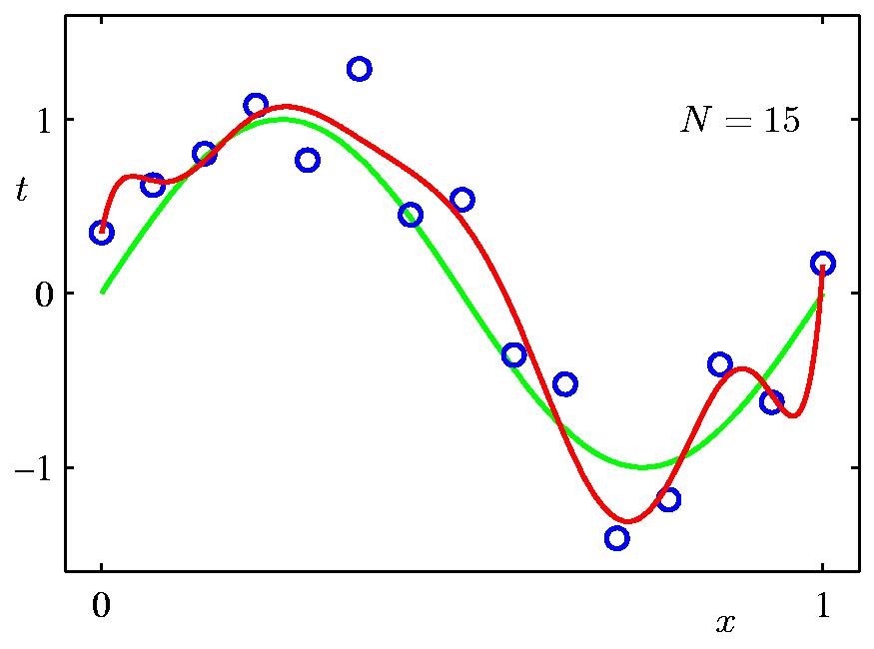
Data Set Size:
9th Order Polynomial

Slide 19

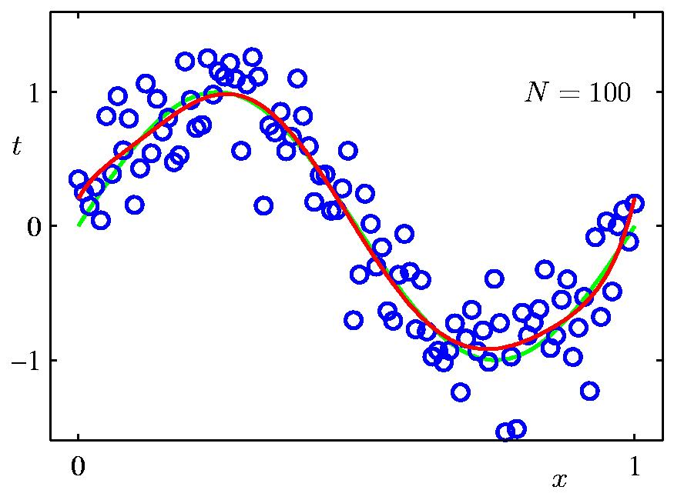
Data Set Size:
9th Order Polynomial
So what is your conclusion?

Slide 20
Over-fitting vs. size of the data set
For a given model complexity, the over-fitting problem become less severe as the size of data set increases.
The larger the data set, the more complex (in other words more flexible) the model that we can afford to fit to the data.
One rough heuristic that is sometimes advocated is that the number of data points should be no less than some multiple (say 5 or 10) of the number of adaptive parameters in the model. ← not necessarily though
There is something rather unsatisfying about having to limit the # of parameters in a model according the size of the available training set. It would seem more reasonable to choose the complexity of the model according the complexity of the problem being solved.

Slide 21
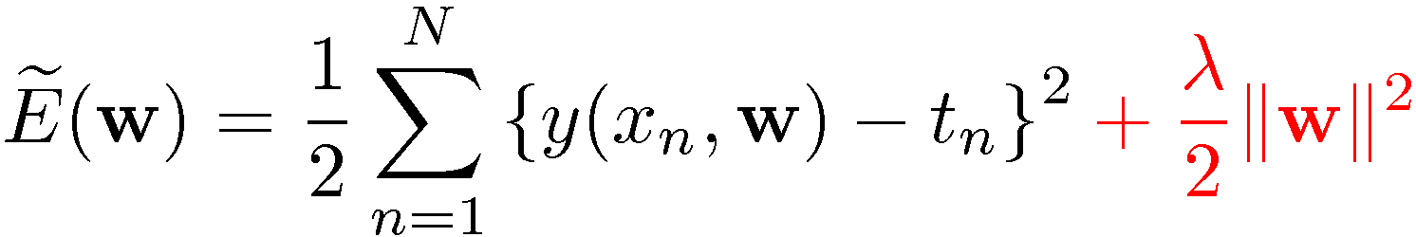
Regularization
λ governs the relative importance of the regularization term compared with the sum-of squares error term
Penalize large coefficient values
ground truth
w^{T}w=w₀²+w₁²+…+w_{M}²
predications
A penalty term to discourage the coefficients from reaching large values

Slide 22

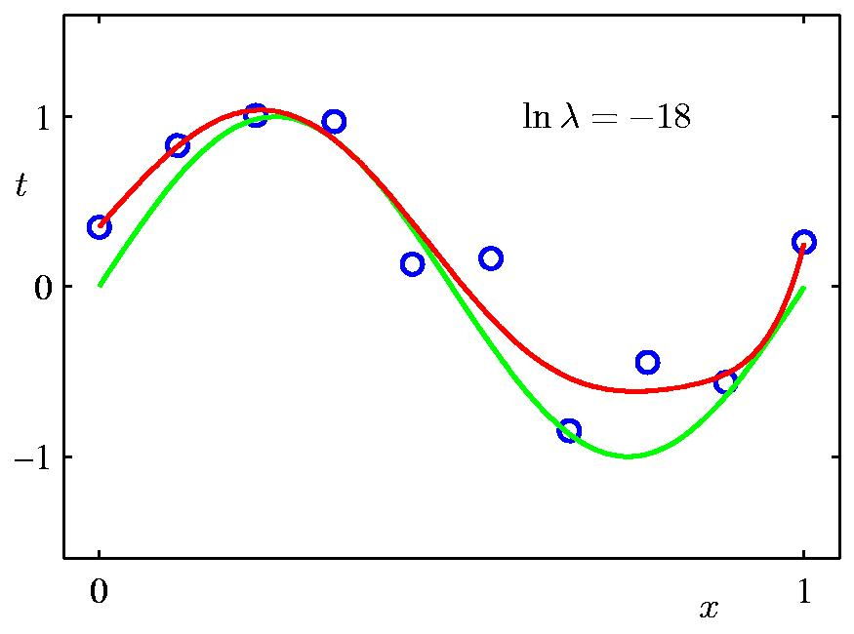
Regularization: and M=9
The over-fitting has been suppressed and we now obtain a much closer representation of the underlying function sin(2πx).

Slide 23

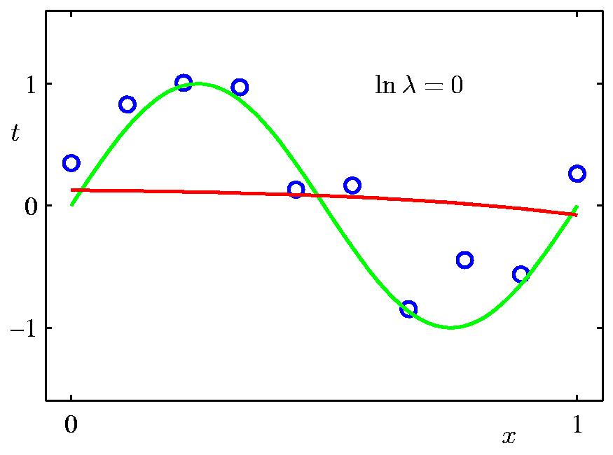
Regularization:
However, we use too large a value for λ then we again obtain a poor fit.

Slide 24
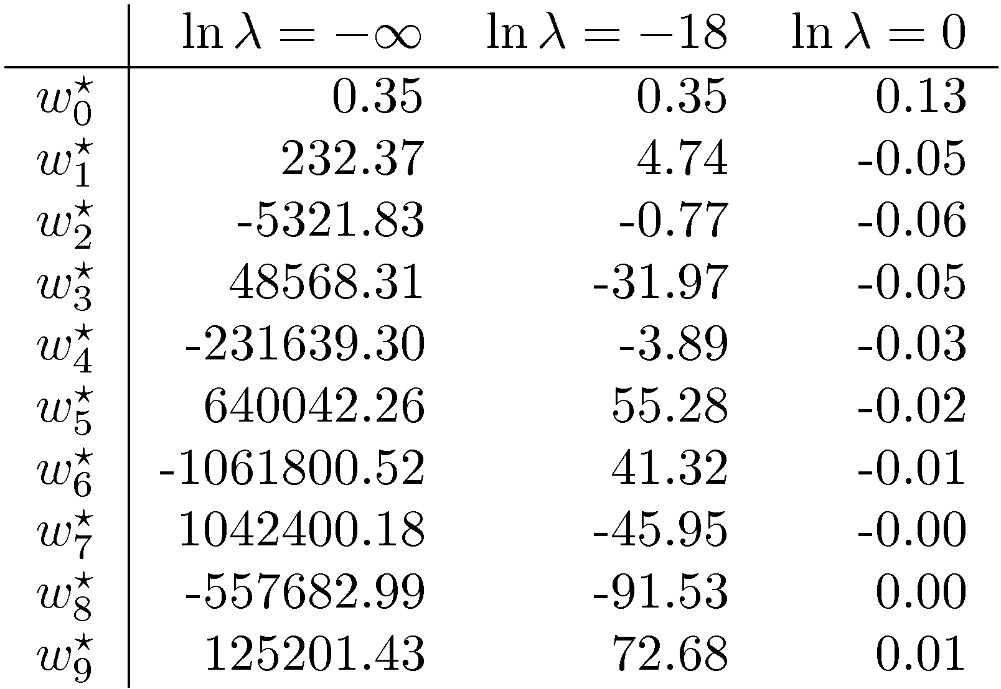
Polynomial Coefficients
The regularization has the desired effect of reducing the magnitude of the coefficients.

Slide 25


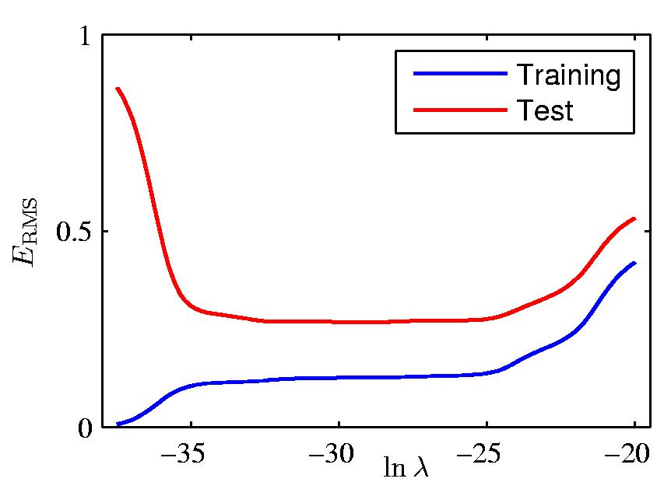
Regularization: vs.
The impact of the regularization term on the generalization error can be seen by plotting the value of the RMS error for both training and test sets again lnλ.
In effect λ now controls the effective complexity of the model and hence determines the degree of over-fitting

Slide 26
Now let’s back to our previous discussion:
How to optimize the final objective function of logistic regression

Slide 27
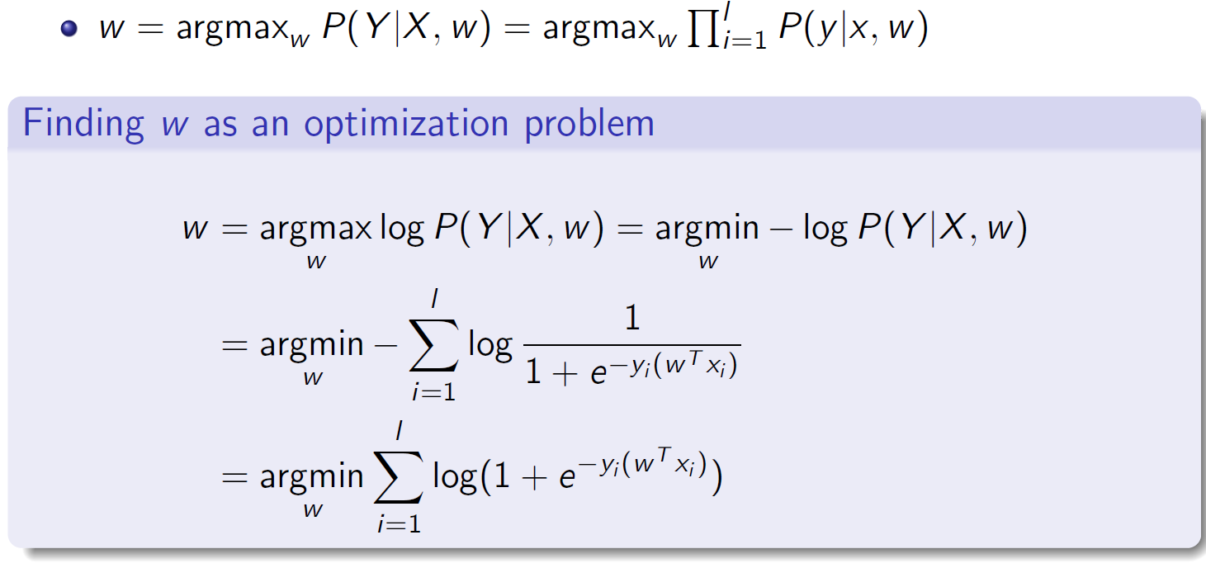

Slide 28
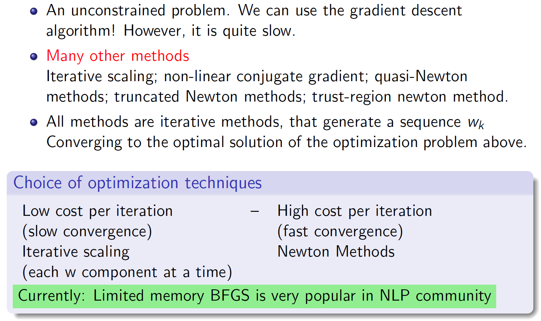
Optimization

Slide 29
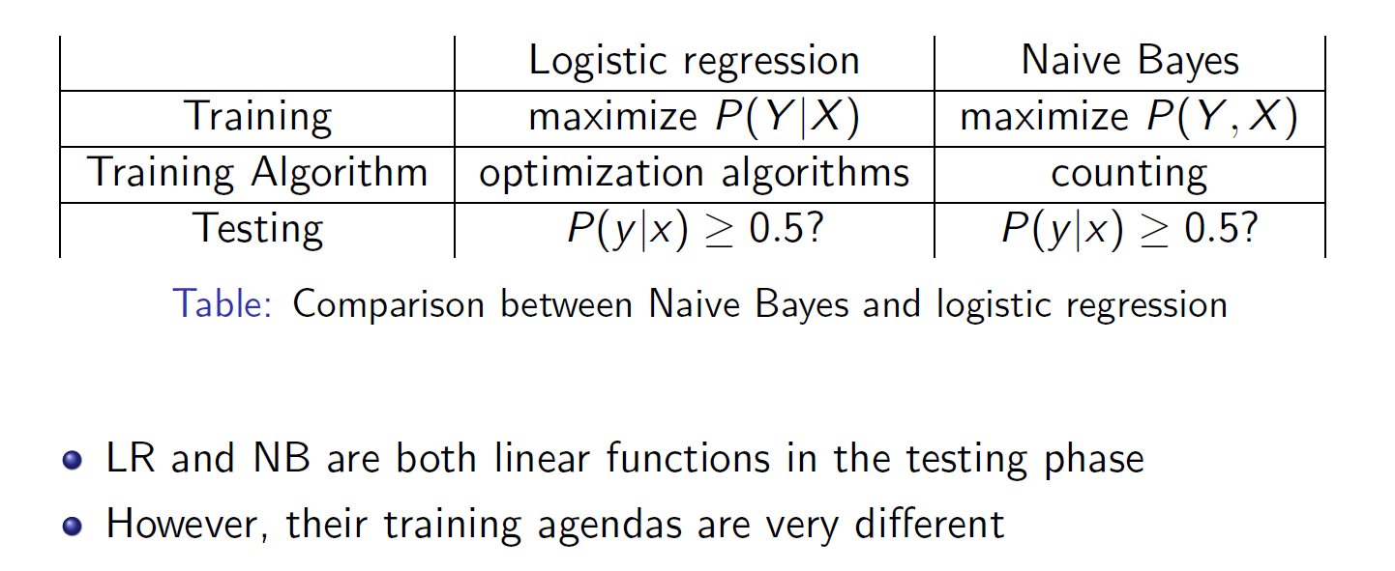
Logistic regression versus Naïve Bayes

Slide 30
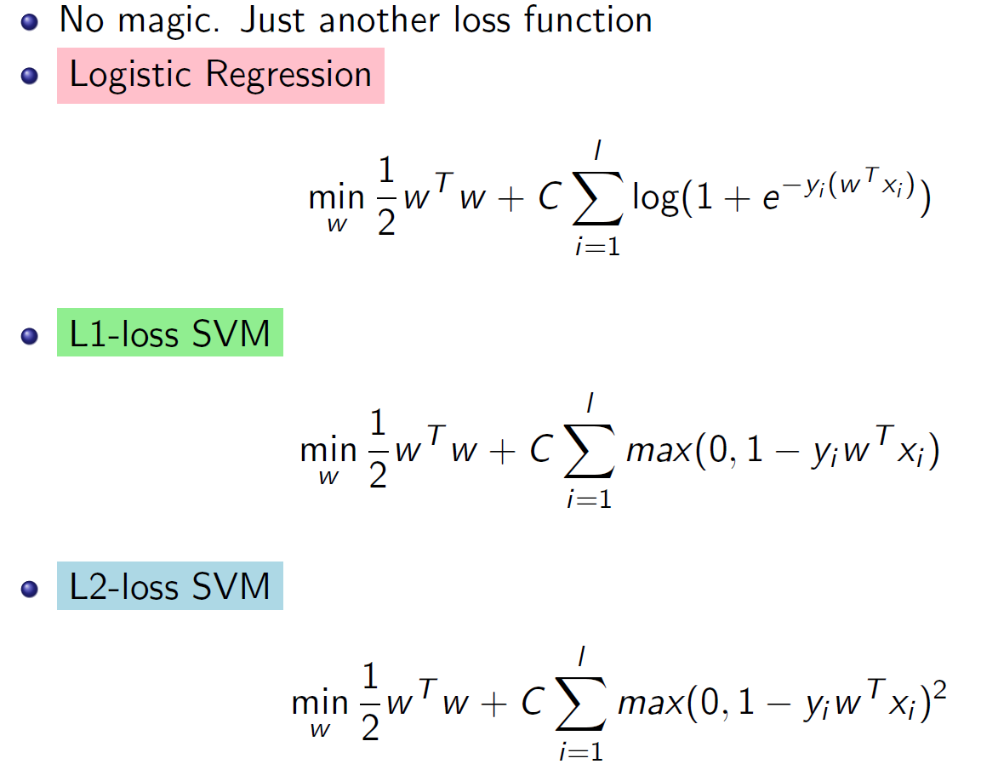
Support Vector Machine: another loss function

Slide 31
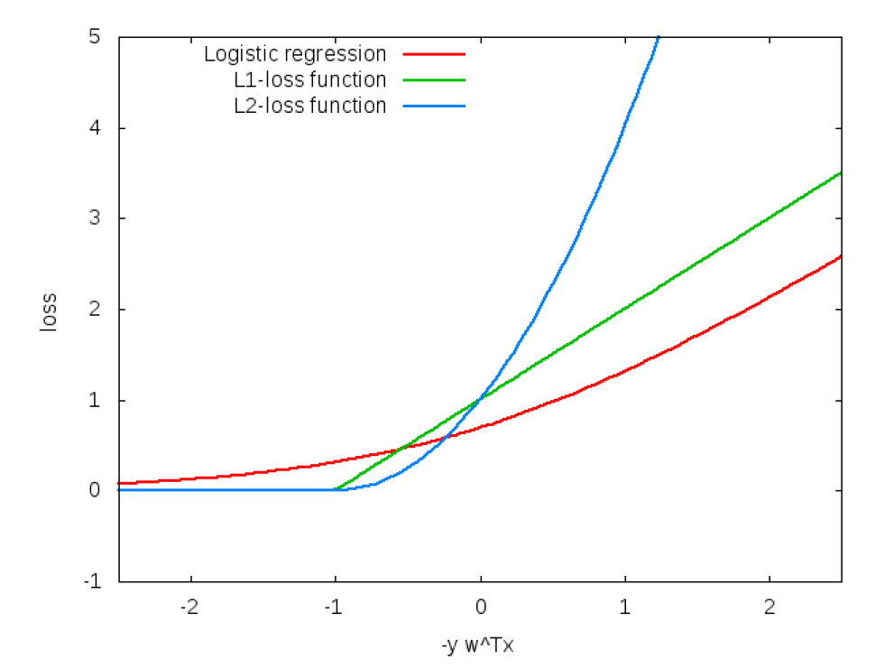
Compare these loss functions

Slide 32
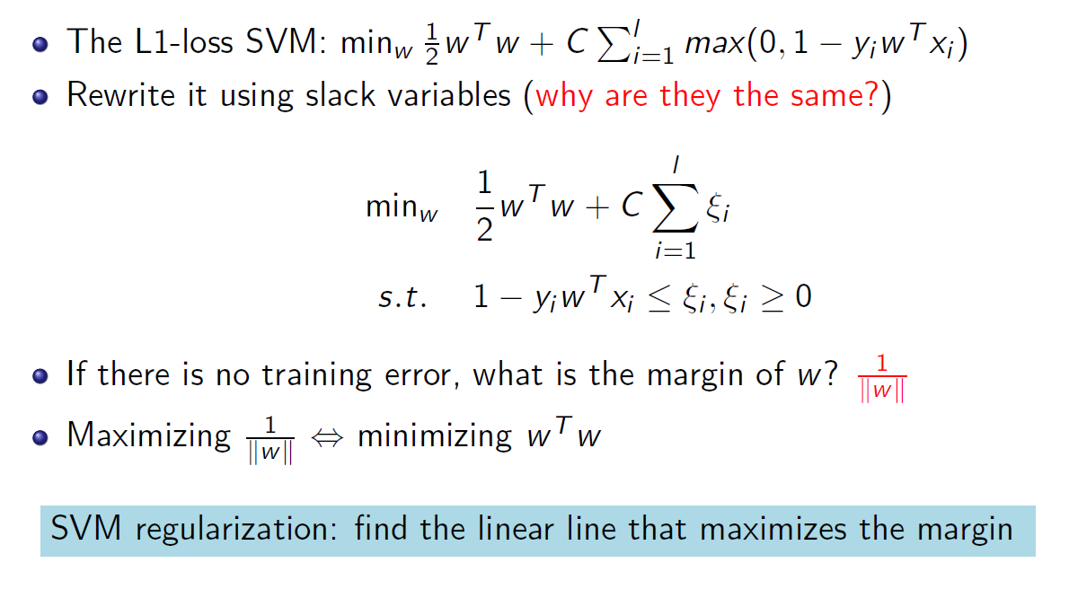
The regularization term: maximize margin

Slide 33
Introduction
Compared to decision trees and Naïve Bayes, logistic regression and support vector machines are “modern” supervised learning algorithms.
Both are batch learning algorithms
Using optimization algorithms as training algorithms
An important technique we need to be familiar with
Learn not to be afraid of these algorithms
Understand the relationships between these algorithms and the algorithms we have learned

Slide 34
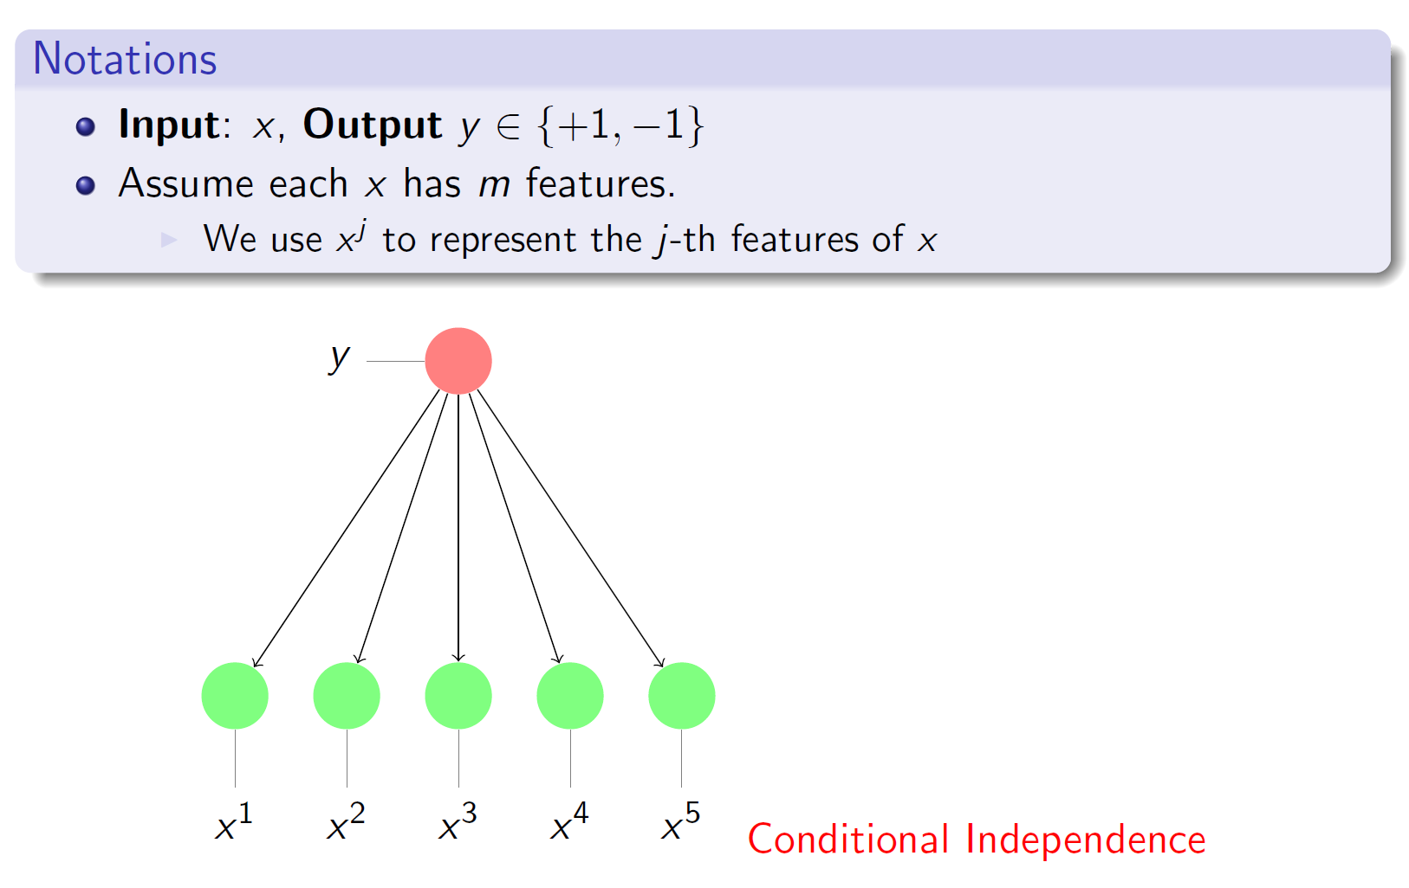
Review: Naïve Bayes

Slide 35
Review: Naïve Bayes

Slide 36
Naïve Bayes: Two Classes
Notice that the naïve Bayes method gives a method for predicting
rather than an explicit classifier.
In the case of two classes, v∈{0,1} we predict that v=1 iff:

Slide 37
Naïve Bayes: Two Classes
Notice that the naïve Bayes method gives a method for predicting
rather than an explicit classifier.
In the case of two classes, v∈{0,1} we predict that v=1 iff:

Slide 38
Naïve Bayes: Two Classes
In the case of two classes, v∈{0,1} we predict that v=1 iff:

Slide 39
Naïve Bayes: Two Classes
In the case of two classes, v∈{0,1} we predict that v=1 iff:

Slide 40
Naïve Bayes: Two Classes
In the case of two classes, v∈{0,1} we predict that v=1 iff:
We get that naive Bayes is a linear separator with

Slide 41
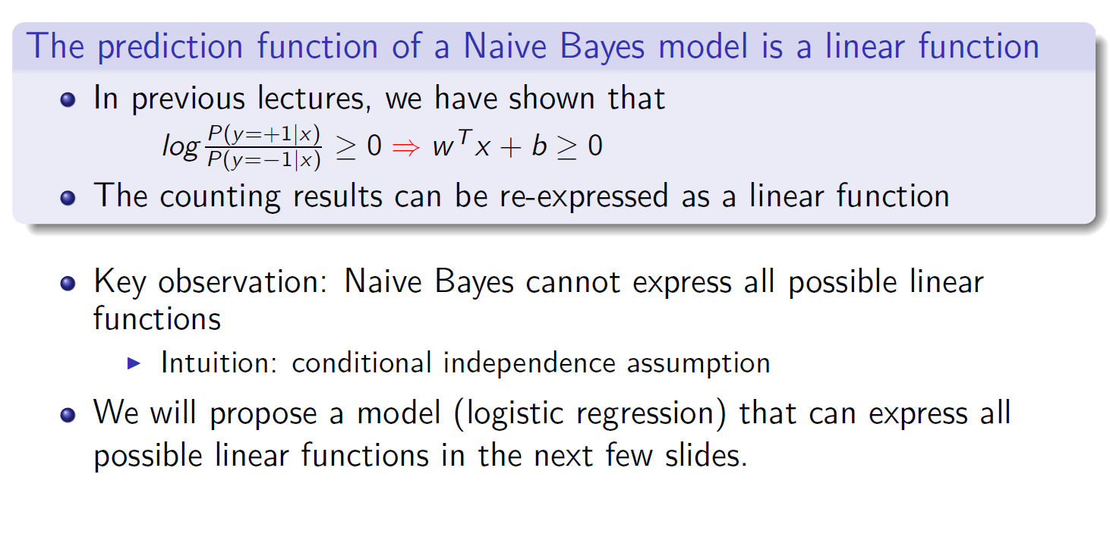
Naïve Bayes

Slide 42
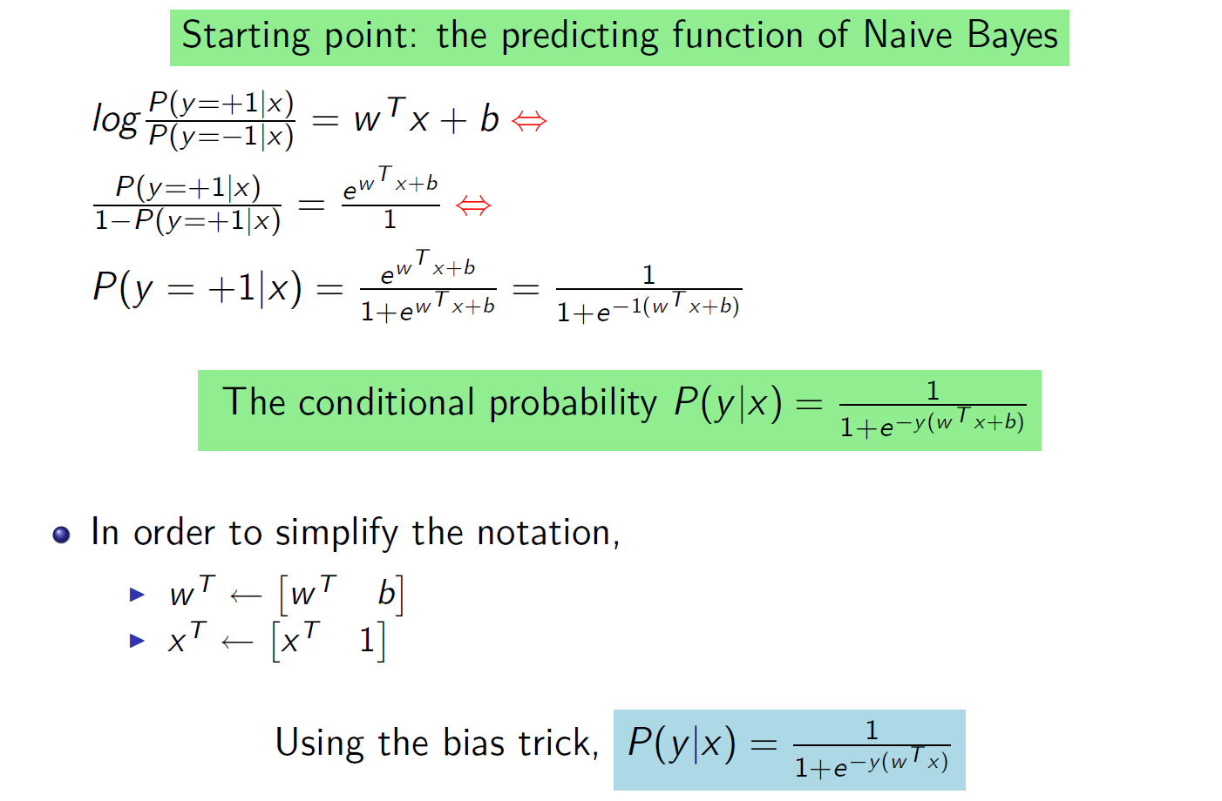
Modeling conditional probability using a linear function

Slide 43
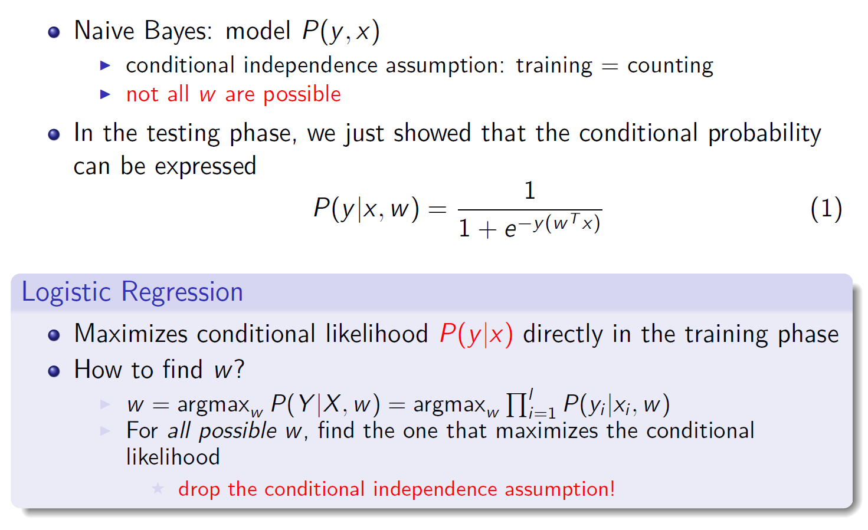
Logistic regression: introduction

Slide 44
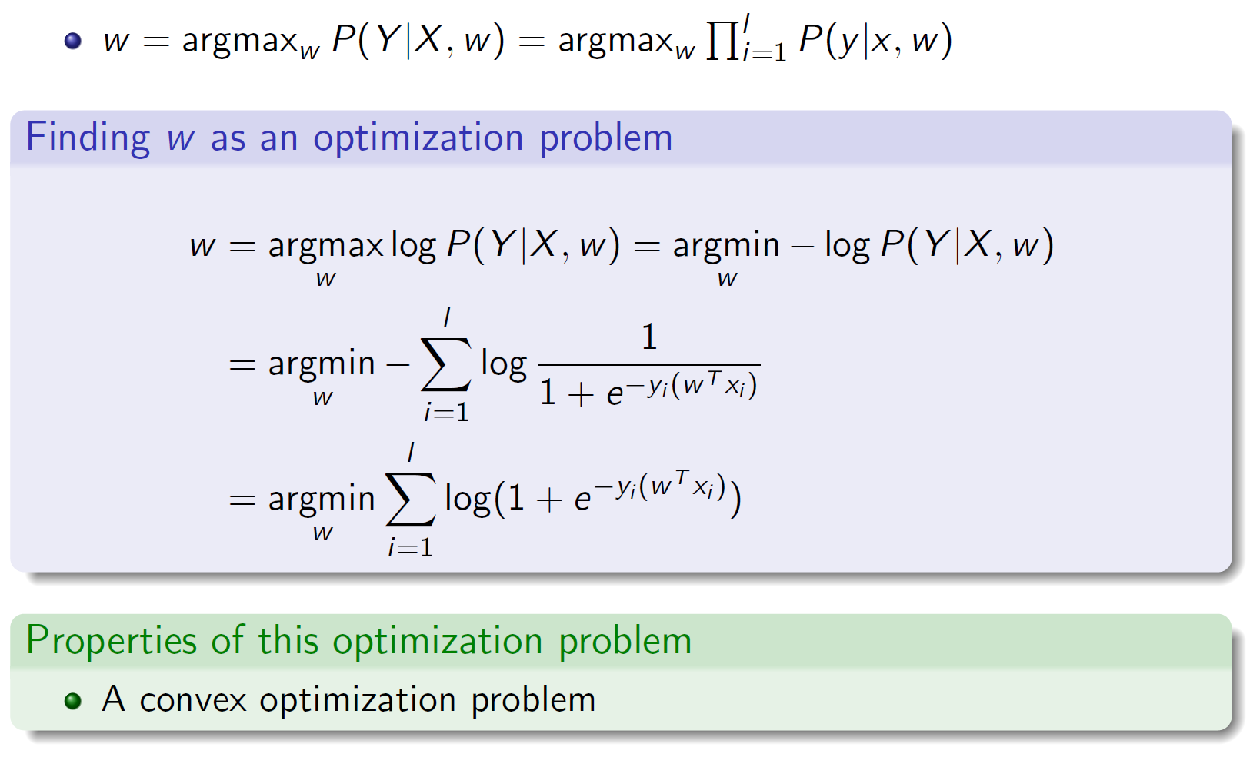
Logistic regression: the final objective function

Slide 45
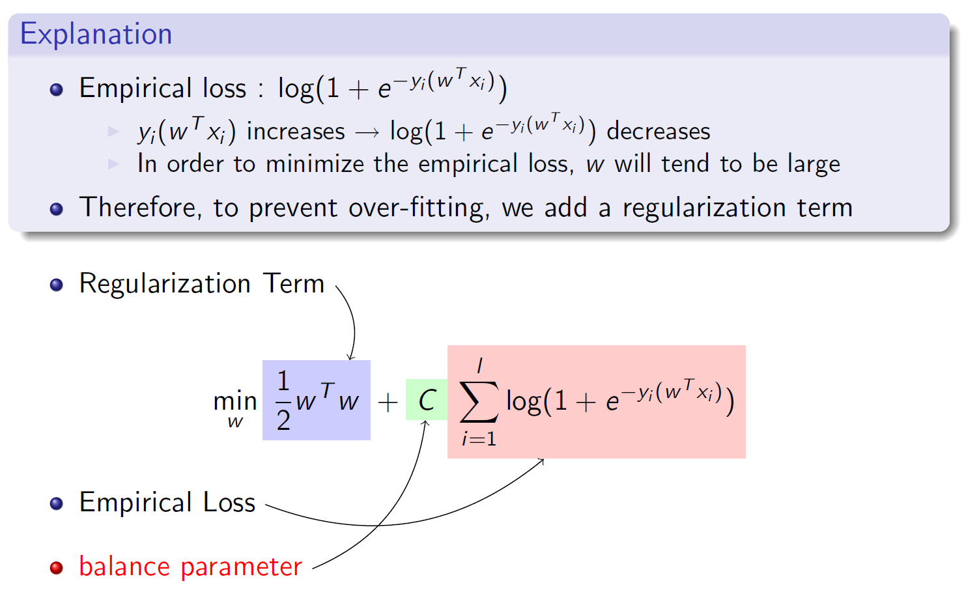
Adding regularization

Slide 46
Now let’s understand Support Vector Machine

Slide 47
Support Vector Machines
Find a linear hyperplane (decision boundary) that will separate the data

Slide 48
Support Vector Machines
One Possible Solution

Slide 49
Support Vector Machines
Another possible solution

Slide 50
Support Vector Machines
Other possible solutions

Slide 51
Support Vector Machines
Which one is better? B1 or B2?
How do you define better?

Slide 52
Support Vector Machines
Find hyperplane maximizes the margin => B1 is better than B2

Slide 53
Support Vector Machines

Slide 54
Support Vector Machines
We want to maximize:
Which is equivalent to minimizing:
But subjected to the following constraints:
This is a constrained optimization problem
Numerical approaches to solve it (e.g., quadratic programming)

Slide 55
Support Vector Machines
What if the problem is not linearly separable?

Slide 56
Support Vector Machines
What if the problem is not linearly separable?
Introduce slack variables
Need to minimize:
Subject to:

Slide 57
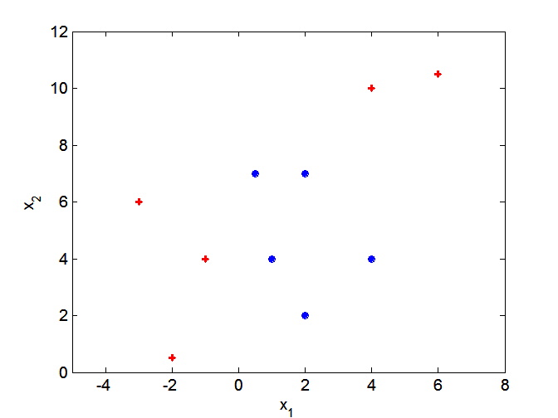
Nonlinear Support Vector Machines
What if decision boundary is not linear?

Slide 58
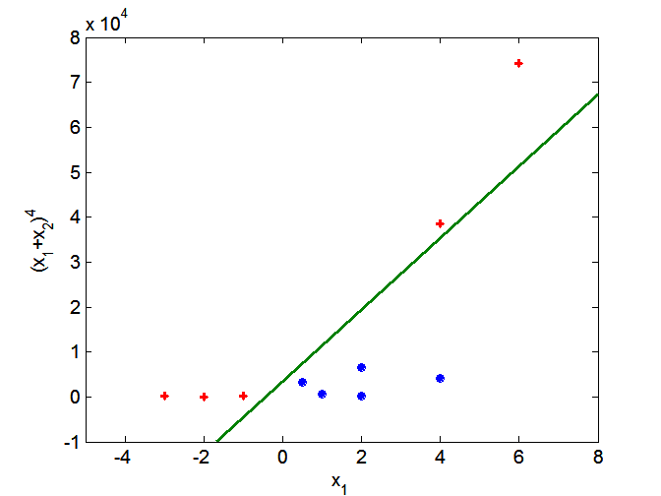
Nonlinear Support Vector Machines
Transform data into higher dimensional space

Slide 59
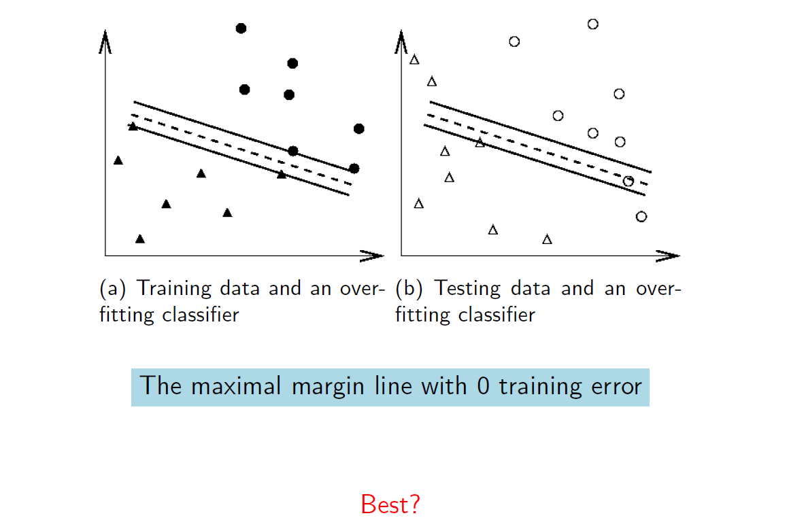
Balance between regularization and empirical loss

Slide 60
